Slide 1

Top Payer Audit (& Denial) Challenges & Strategies for Success
Day’s Revenue Cycle Motto:
My patient did not ask to get sick. My patient did not ask to have their bill be so high. My patient did not ask for their insurance to pay so little or deny their claim. My patient did not ask to have their life disrupted by this unexpected illness. How can I help? You are scared and sick. Let me be the Patient Financial Navigator!

Slide 2
“The mind is a flexible mirror. Adjust it to see a better world” Amit Ray
“Secret of Life is to fall seven times; get up eight times.”
Paulo Coelho
The Power of One!” “Leading with Energy and Excellence” Day Egusquiza
“You're looking for three things, generally, in a person,” says Warren Buffett. “Intelligence, energy, and integrity. And if they don't have the last one, don't even bother with the first two."" AMEN
Some great thoughts…

Slide 3
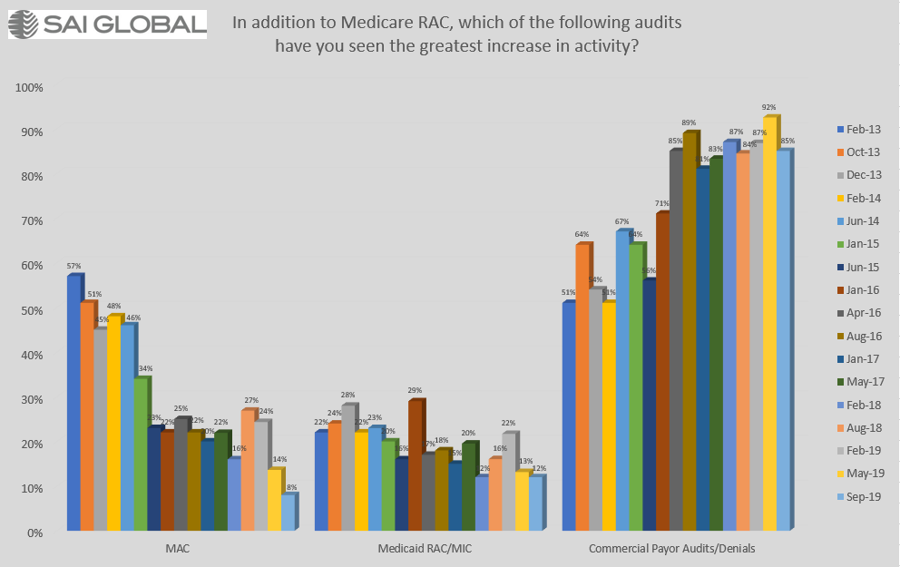
8 year history with Compliance 360
SAI Global – free webinars…

Slide 4
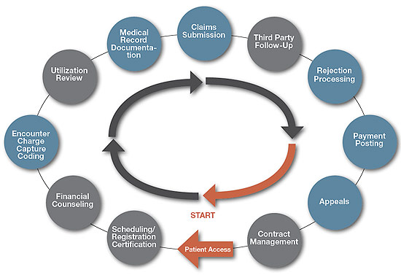
Scope of Revenue Cycle Integrity
Medical Staff
Clinical Staff
Clinical Documentation
Improvement (CDI)
HIMS
IT
Finance
Finance
Care Management
Care
Management
Physician Advisor Nursing
Physician Leader
Hospital Leader
Finance
Nursing
Ancillaries
HIMS
Finance (Correct
Charge Master)
Finance
Care Management
Physician Advisor
Compliance
Business
Office
Care Management
Finance
Contracting
Care Management

Slide 5

Covid-19 Quick Highlights
Public health emergency extended thru end of the year. Waivers as outlined by CMS are still in effect. (1-22/renew every 90 days).
CARES ACT= no charge for the vaccine or administration. Insurance billed/they pay. If no insurance/HRSA. But no ‘cost share’ to the pt for administration of the vaccine. Add-on Booster approved. $40 for adm cost payment.
Cost of testing for COVID: ranges from $240/ARK with many averaging around $145. If the pt goes to the ER or urgent care center, there will likely also be a facility fee. Billed to insurance/pt. *Some payers waived, same no longer are. Some providers waived OOP.
20% add on to DRG for confirmed test in record. Lots of challenges with transfers, indept labs, locations, EMR, etc. FOR MEDICARE Patients. (ID: ave age 72; now 58. Different payers)
Optum process/uninsured/HRSA – COVID dx in primary to be paid. As of 12-20, only $880M to 8000 providers pt instead of the $13-41B expected. WHY? Update: 3-1-21 $3B pd to providers
Extended recoupment of Accelerated payment amount. 1 yr for repayment from the date requested= 25%, 50% 2nd yr and in full by the 3rd yr. Reflected in remittances under provider level balance/PLB. (MLN Matters SE21004, April 1, 2021-repayment for accelerated & advance payments, begins 3-30-21)
AHA & Kaufman Hall 9-21: Delayed care & higher expenses for supplies, labor, and drugs – hospitals will lose about $54B in net income this year after taking in to account their CARES $. W/O losses would be $95B. HOT: -15 operating margins w/o CARES. Labor & total expense: up 16% Oct 20-Oct 21. (MCOL Factoid 11-21)
Death toll: 900,000+ approx. 2100 daily. “Long COVID.’ (Cost too!) 10-25% still struggling after several months. National movement to address. Delta Variant –highly contagious/unvaccinated. 95% of ICU & Hospitalized are unvaccinated. (New Variant: Omicron 11-21. More rapidly spreading them Delta; likely less severe for vac.)
1 in every 100 deaths over 65. (600,00 of 800,000) 1 in 4 Idaho deaths in LTC US: 7M++ Children
Vaccine rollout – Nation: 65% fully/1-22. Idaho: Declared ALL hospitals ‘crisis care standards’ – new levels for care/10-21 until 11-20. Back in end of Jan. Multiple states at or close to Crisis of Care Standards. FINAL RULE– require staff within all Medicare & Medicaid facilities to be vaccinated per Supreme Court .
Explosion of Virtual Care Options. Challenges with long term all payer coverage of all codes; bandwidth; no internet; payer rates so low providers rejecting telehealth *UHC & Medicaid. Traditional Medicare finalized 24 codes.4-21. Still looking at ‘no phone only’
“Most health plans have stopped waiving cost-sharing for COVID-19 treatments” – HFMA 8-21. Many more pts will receive large bills now.

Slide 6
Topics for fun discussion- External Payer Issues
Traditional Medicare
  2 MN /short stays
  RAC focusing on joint replacement/short stays
  Other audits that result in changes to prior authorization, other
  OIG looking at lab billings/COVID testing
Medicare Advantage/Part C
  Record request- Risk adjustment
  Prior authorizations
  Post payment denials
  3 ‘s: DRG Downgrades, Inpt vs Obs Disputes, Readmission Denials
Other payer
  Prior authorizations
  Site of service
  ER E&M/payer specific requirements
  ER vs non-emergent
  Inpt vs obs – what criteria?
  Line item audits
  Post payment denials *Think surprise billing protection to the pt.*

Slide 7
And how about internal charge capture auditing to find lost revenue and compliance risk?
When conducting internal audits for lost charges/charge capture, does it pass the ‘3 step” test?
When developing new revenue/charges, ensure it is a billable service.
When looking at a billable service, did the dept head own accountability for order, documentation and correct charge capture?
Who teaches the reimbursement rules to the dept heads?
What type of ongoing education is occurring once a charge ‘goes live?”

Slide 8

Payer: Traditional Medicare
RACS Are Back! Audits are Back!
“CMS expects to discontinue exercising enforcement of medical review audits regardless of the status of the PHE.’ - 8/2020¹
RAC Examples: total hip and total knee: Medical necessity and documentation requirements. Duplex scans of extracranial arteries: Medical necessity & documentation requirements. Implantable auto defibrillator –inpt. (Same) All A/B MACS. (More listed) 20% are still doing all joints as inpt per PEPPER report/end of 2020.
SMRC/supplemental medical review contractors has current projects and closed projects. Closed: Spinal fusion 25% error rate; Emergency ambulance 98% error rate; non-emergency ambulance 79% error rate. (Hint: Spinal fusion has now moved to prior-authorization 2021)
MAC Examples: targeted probe and educate/TPE. Pre-claim reviews: prior authorization for 5 identified outpt procedures. (TPE – common issues on CMS webpage.) Now including Spinal Fusion…more?
¹(www.cms.gov/research-statistics-data-and-systems/monitoring -program/medicare-ffs-compliance-programs/recovery-audit-program/approved-RAC-items)

Slide 9
More Medicare focused auditing
Provider Relief Act – looking
OIG is conducting a ‘series of audits of Medicare B lab services that focus on aberrant billing of COVID-19 testing during the pandemic.’
Short Stay inpts continue to get attention. 2 MN presumption, 2 MN benchmark can have 1 MN stays. Outlined Plan that was met unexpected early= 2 MN presumption. First MN in outpt setting, as 2nd MN approaches, is there a clinical reason to be in a bed? Outline the plan for the 2nd MN and convert to inpt= 2 MN benchmark.
Livanta/QIO -national contract for high weighted DRG and short stay audits for the country. 4-21

Slide 10
Financial Impacts of Change- Traditional Medicare – TKA
*Critical Access Hospitals are paid differently*
Facility Payment
Patient Responsibility
Inpt DRG: 470
Avg: $10,630 (JJ-GA, AL, TN/34,777 cases J to J 2017)
Avg: $12,010
  DRG is wage adjusted + teaching +++ upward of $15,000-$30,000
APC Payment for CPT 27447/APC 5115
Avg: $10,122 *
  APC is wage adjusted:
  Higher = higher payment;
  less than “1” wage factor = lower than base payment
Inpt every 60 –day deductible:
$1408/2020 $1484/2021
APC frozen amt per CPT:
$2024/20% of APC$ -but cannot exceed inpt deductible. CMS pays the difference to the site.
Max amount due from pt:
Inpt Deductible –whether inpt or outpt.
PS: Physician is paid the same –inpt or outpt

Slide 11
Let’s Get Updated on Numerous
CMS audit activity
+ Probe and educate
2 MN rule with short stays

Slide 12
Probe & ED Round 1- WPS data- RAC SUMMIT 11-16
 | J5 | J8
Part A Hospital Provider Count | 800* | 300*
# of Providers Sampled | 412 | 151
# of Claims Reviewed | 3,625 | 1,328
Approximate number
J5- NE, IA, KS, MO
J8- MI, IN

Slide 13
Overall Denial Rate- WPS
J5 27%
J8
26%

Slide 14
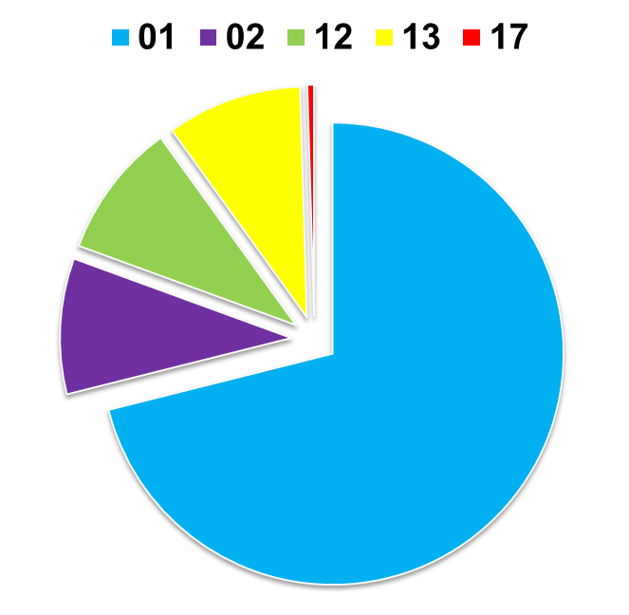
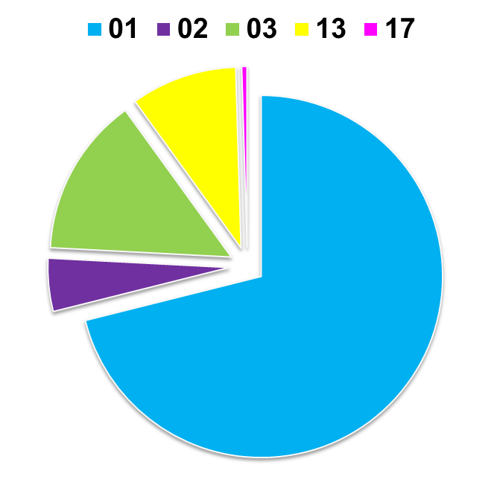
Denials by Type - WPS
J5
5PC01 | Documentation does not support services medically reasonable/necessary (PS PLAN!!)
5PC02 | Insufficient documentation
5PC12 | Order missing
5PC13 | Order unsigned
5PC15 | Certification not present
5PC17 | No documentation of 2-midnight expectation
J8

Slide 15
Novitas -Probe and Educate Medical Reviews – First Round
JH: CO, NM, OK, TX, AR, LA, MS JL: PA, NJ, MD, DE, Dist of Co
PRESENTED TO THE RAC SUMMIT 11-16/Dr Anderson, Medical Dr
 | # Providers | # Claims Reviewed | # Claims Denied | % Claims Denied
JH | 1004 | 3794 | 2206 | 58%
JL | 586 | 2712 | 1720 | 63%

Slide 16
Top Reasons for Denial – Novitas- First Round
Denial Reason | % Denials JH | % Denials JL
Documentation did not support two midnight expectation (did not support physician certification of inpatient order) (PS PLAN!) | 50% | 51%
No Records Received | 29% | 28%
Documentation did not support unforeseen circumstances interrupting stay | 11% | 11%
No inpatient admission order | 3% | 3%
Admission order not validated/signed | 4% | 3%
Other | 3% | 4%

Slide 17
P&E findings: First Coast/MAC
244 hospitals: FL, PueRico, VirIsland
1st round:
  35% denial rate
REASONS:
  55% failed to document need for 2 MN (PS PLAN!)
  45% failed admission order requirements
    48% signed after discharge
    39% order missing from the record
    13 % order not signed
2nd round:
  36% denial rate
REASONS:
  40% failed to document need for 2 MN (PS PLAN!)
  60% failed admission order requirements
    35% order missing from record
    17% order not validated
    8% order not signed (as of 2-11-15)
  MAC recommendations:
  Providers document their decision making process. Paint a clear, concise picture of the pt.
HINT
HINT

Slide 18
What is a Medicare Inpt?
Per WPS-MAC/Medicare claims processer/auditor (July 23, 2014)
“If there is one place I would recommend beefing up the documentation, it is the plan. There are many patients who present in very acute , life threatening ways, who do not require 2 MNs of care. (think CHF) The plan, along with the diagnosis/clinical data on the claim are the 2 biggest supporters of the physician’s reasonable expectation especially if that expectation isn’t met. If all you have is ‘monitor overnight and check in the morning’ – you are going to have a hard time supporting a part A/inpt payment, regardless of the symptomology. You could also add an unexpected recovery note at the end of the record, if they get well faster than the doctor thought at the time of the inpt order and expectation of 2 MN. But in this ex, you’ll have to explain what you expected and what actually happened. It would be less charting if you actually just had a good plan up front.”

Slide 19
Inspector General Audit
1 MN stays –Specific Hospital Findings 12-20
Appealed review. *Extrapolated recoupment (KS hospital)
Findings: Provider did not indicate expected 2 MN stay with early unexpected d/c. & medically necessary care could have been in a lower level of care.
Stratified sample – requested funds returned for all.
APPEAL: CMS said ‘inferred’ need for 2 MN would be acceptable. “Physicians need not include a separate attestation of the expected LOS, rather this information can be inferred. Medicare program integrity manual, Cpt 6, 6.5.2”. Auditors used hindsight in determining the pt didn’t need inpt LOC.
Outcome: Still appealing. Lesson learned: Declare the need for 2 MN presumption /2 MN benchmark with a PLAN for the expected 2 MN stay… TELL the pt story…not just the order.

Slide 20
Anguish of Prior Authorization – High Value vs Low Value with many payer approvals.
Delays in medically necessary, physician ordered, patient specific care
21% of 182 M authorization transactions were full electronic in 2020.
Provider authorization processes:
  Eligibility verification check - 12 min
  Determine if an authorization request was already filed.- 3 mins
  Inquire if an authorization request was already filed. – 2 mins
  Submit authorization request – 11 min
  Process payer’s clinical questions and requests for additional information – 15 mins
  Inquire concerning authorization request status – 2 mins = 45 mins. (CAGH index 2020)
  And what if the initial request is denied? Now alternatives? Patient notified? Provider tried to appeal? Cost and impact to pts’ health.
  What about the hospital UR, Cancer, Imaging, etc. other departments? Is this cost even tracked?
“AHA urges CMS to address Prior authorization issues affecting Medicare Advantage patients.”
New, input request to the Biden Adm on the need for mandatory electronic submission and timelines for replying. (Question: Who sets the rules for what services need prior auth? What are they and how can the providers know the rationale behind)
Value based care = focusing on high value procedures, not excessive outpt volume. (Problem – many payers requires low acuity procedures, ex xrays, prior to approving a higher acuity procedure, ex. MRI. Overutilization? And patient pays due to high deductibles. How does that drive down the cost of healthcare –to the system and the pt?) High value determined by ea payer.
Denials steadily rising, up to 10.8% 2ndQ 2020 – ½ of claim denials are caused by front end RCM such as prior authorization. (Change healthcare 2016-2020)
AMA research – 14 hrs weekly spent trying to get prior authorization. Impact to pt care.

Slide 21

CMS guidance on Prior Authorization
2-18-21: Biden Adm “pause” rollout to assess
Final rule is out! Most provisions go into effect 1-1-23. Payers slam as ‘half baked’. Rushed as the sweeping rule revamping electronic prior authorization was finalized a scant 30 days from when it was proposed/Dec 10,2020. Codified just 5 days before the Biden administration.
The rule requires all Medicaid, CHIPS and those plans operating on federal exchanges which are commercial insurance plans to use standardized application programing to give providers and patients electronic access to prior authorization data, including pending decisions. Payers also have to give faster decisions. In 2024, Maximum of 72 hrs for urgent and 7 days for standard requests.
BIG concern!!! Medicare advantage plans aren’t included in the final rule, but CMS is considering further rulemaking to make them similar. That omission was a major hang-up for hospital groups which argues excluding the private plans –which cover about a 1/3 of the Medicare beneficiaries – could result in more variation in prior authorization processes in the U.S. and reduce incentives for providers to adopt the new standard methodology, per AHA.
Per a 2019 AMA survey of physicians – 14 hrs of each week is dedicated to trying to get prior authorization for care the physician believes is necessary for the patient’s care…including ongoing drug therapy. Didn’t even ask the hospitals about their costs with prior authorizations!
Faxing vs creating secure portal to ‘place’ all medical records for payers. Control what is seen but also allow for rapid review and decisions.

Slide 22
UR’s role: First Touch
Key elements to success of UR:
Understanding each payer’s rules for determining an inpt status.
Each payer has their own. Who is the payer, what are the rules?
Traditional Medicare does not use IQ or MCG. The 2 MN – presumption and benchmark
Develop a payer matrix that includes timelines for payer notification, type of payment from each payer/per day/DRG/% of billed charges, arbitrary guidelines, observation guidelines, etc.
Physician documentation will guide the supporting of inpt acuity.
Coordinate with providers, CDI and internal physician advisor for ongoing education.

Slide 23
UR’s 2nd touch- Traditional Medicare
Traditional Medicare/TM – it is all done internally using the 2 MN rules.
2 MN presumption – anticipate the pt will need an estimated 2 MN to resolve care. What is the plan? (First touch)
2 MN benchmark – as the 2nd MN approaches in an outpt status (ER 1st MN/need 1 more to be an inpt or 2 MN in obs) –is there a clinical reason to be in a bed? Yes, what is the plan?
Is a 1 MN stay allowed under TM’s 2 MN rule? Absolutely. If there was a plan for 2 and the pt had an early unexpected discharge = 1 MN inpt billable. If the pt had 1 outpt MN and then a 2nd medically appropriate midnight = 1 MN inpt billable.
Key- the plan outlined. Documented and met early or met the 2nd MN.

Slide 24
UR’s 2nd Touch- Other payers
Other non-Traditional Medicare payers
Submission of records using the payer’s KNOWN definition of inpt.
Reviewing the record – from the ED as all records from CDI or other interaction with the pt may not be available by the time records are due to the payer. Clarify internally
Outline WHY the pt is an inpt – using their criteria PLUS co-morbid conditions, risk factors, other documentation to support inpt.
Observation is a ‘fall back position’. Doesn’t meet, no other factors… but don’t ASK for observation. ASK for inpt. Learn why the payer won’t approve inpt.
Track and trend/TNT by payer.
Develop a payer matrix – all rules, timelines, etc tied to contract. Knowledge is power!

Slide 25
Prior Authorization Request for Inpatient
Non-Traditional Medicare/TM payers (TM- we do our own/2MN rule)
Patient Name DOB:
Insurance name: Subscriber #: (SAMPLE FOR SUBMISSION WITH RECORDS TO PAYER/UR)
Records sent /attached to support inpt request:
ER physician
ER nursing notes
Lab results
Imaging results
H&P
Other ___________
Additional justification to support inpt request:
Meets clinical guidelines for the following diagnosis and course of treatment: (List)
IQ or MCG: (List their supporting info)
Other co-morbid conditions that will impact the need for inpt level of care: (List)
Known or suspected risk factors that further support inpt: (List)
Based on the attached and the above additional justification:
Inpatient patient status is requested. _____
If inpt is denied, we would request the justification for same to be included in the decision letter. A Peer-to-Peer call will be immediately scheduled as necessary. ( CMS Form 1696/Appointment of a Representative has been completed by the patient.)
Outpt observation level of care, at the beginning of care, with the immediate intervention to move to inpt if the patient’s condition ‘rules in,’ or other clinical indicators are identified. _____ NOTE: Inpt will be requested immediately upon meeting inpt criteria.
Respectfully submitted,
Name, UR Team
Date /time sent to payer_________

Slide 26
Regulations 42 C.F.R. § 422.214
If non-contracting with a MA plan….
§ 422.214 Special rules for services furnished by noncontract providers.
Services furnished by non-section 1861(u) providers.
  Any provider (other than a provider of services as defined in section 1861(u) of the Act) that does not have in effect a contract establishing payment amounts for services furnished to a beneficiary enrolled in an MA coordinated care plan, an MSA plan, or an MA private fee-for-service plan must accept, as payment in full, the amounts that the provider could collect if the beneficiary were enrolled in original Medicare.
  Any statutory provisions (including penalty provisions) that apply to payment for services furnished to a beneficiary not enrolled in an MA plan also apply to the payment described in paragraph (a)(1) of this section.
Services furnished by section 1861(u) providers of service. Any provider of services as defined in section 1861(u) of the Act that does not have in effect a contract establishing payment amounts for services furnished to a beneficiary enrolled in an MA coordinated care plan, an MSA plan, or an MA private fee-for-service plan must accept, as payment in full, the amounts (less any payments under §§ 412.105(g) and 413.76 of this chapter) that it could collect if the beneficiary were enrolled in original Medicare. (Section 412.105(g) concerns indirect medical education payment to hospitals for managed care enrollees. Section 413.76 concerns calculating payment for direct medical education costs.)

Slide 27

3 Legs of Anguish – Pt Status, DRG Downgrades, Re-Admissions- Medicare Advantage
DRG Downgrades – what documentation standards are required to allow all physician inclusion of ALL dx the pt has and are included in the thought process/not always the actual treatment?
Pt Status Disputes– what is their definition of an inpt?
Readmission Denials - Related means? 30 days when CMS does not use this standard. Preventable means?
Hint – all must be in the contract! Usually silent.
Look to operational addendums vs
Payer –specific policies… UGLY
Why are you contracting? No directing of patients. So what is the win for the provider? Payer win is discounting. Out of network, competition. MA plan cannot sell in your community without a provider network.

Slide 28

DRG Downgrades
Lots of discussion regarding tying in the diagnosis outlined to the treatment. Simply listing dx is not sufficient to ‘earn the higher DRG payment.”
Differing interpretations of ‘co-morbid’ conditions.
Differing interpretations of ‘primary and secondary ….reasons for admit.’ Different DRG assigned.
DENIAL PREVENTION: The HIPAA standard transactions.. Required all covered entities/payers to follow the outlined coding rules. They have to follow correct coding rules; so quote HIPAA and share the coding rules that makes the dx code correct, order of dx codes, etc.

Slide 29
Patterns from payer determination letters: Aetna (ex)
Aetna: MA account. Using clinical guidelines. ‘We use national recognized clinical guidelines such as MCG, as well as clinical policy bulletins to support these coverage decisions. Coverage has been denied for the following reasons:
We used inpt and surgical care MCG guidelines. The requirements for coverage are: (1) active bleeding w or w/o high-risk endoscopic features; (2) hemodynamic instability; (3)severe anemia causing heart failure, cardiopulmonary symptoms and /or cognitive impairment; (4) severe liver disease or abnormal coagulation; (5) treatment intensity or monitoring that requires inpatient treatment; (6) severe thrombocytopenia; (7) inability to tolerate oral hydration; (8) previous aortic graft placement or known aortic aneurysm; or (9) documentation of significant active comorbid conditions requiring hospitalization. The member did not meet any of these requirements.
PLUS: Peer to peer: ‘It you are a treating practitioner and you disagree with a coverage denial, you may request a peer to peer with the Medical Director who made the decision. Follow fax: Scheduled P2P call within 14 days to speak to Med Director. (DOS: 5-18 Rec Ltr: 5-24. 6 days)
***Change of internal request for inpt. Develop a payer matrix to know exactly what every payer is using. MA plans – use CMS form to create a representative for each MA pt/ internal PAs.

Slide 30
Is patient still inhouse? (ex)
United. MA plan. Level of care determination/while in house. Note: Moved from MCG to IQ, May 2021. Bought Optum who owns IQ.
“Not met? My determination is based on the health plans and Medicare criteria that says a member must show signs and/or symptoms severe enough to need services that can only be provided safely and effectively on an inpt basis. (Major subjective! )
Based on my review, these criteria haven’t been met. My rationale: this pt was admitted on 4-7-21 with sepsis unspecified organism. We reviewed the medical information made available to use, as well as the health plan criteria for admission to the hospital, and have determined that this does stay does not meet inpt admission.
The reason is there was no hemodynamic instability. Hypoxemia, altered mental status, bacteremia, parenteral antimicrobial regimen that must be implemented on an inpt basis. Consequently, acute inpt hospital admission is not covered.” (IQ guidelines + UHC)
What to do if disagree? You can request a P2P review. Send secure email or call #.
Can a claim be submitted for this claim? If you submit an inpt claim, it will automatically be denied. You will received reconsideration process on your remittance. DOS: 4-17 Ltr Rcd: 4-21
You can still submit an outpt claim for all medically necessary services. Look to Medicare Claims Processing Manual, 100-04, Chapter 1, Section 50.3.2. (Condition code 44/TM)
WOW! UHC is using their own criteria, not the 2 MN rule, requiring hospitals to submit for review and then requiring the hospital to follow Traditional Guidelines/CC 44 when denying. WOW! NO WAY!

Slide 31

DRG = 1 payment for the entire stay
Traditional Medicare for larger facilities = DRG. Each DRG has a mean LOS that the payment is based on. The diagnosis and inpt procedures are grouped into a single DRG payment. Some DRGs have higher payments based on co-morbid conditions. There is a small variation for each site but: 1 stay = 1 $.
Medicare Advantage pays= same DRG methodology –with coding rules controlled by the HIPAA Standard Transactions 2003. 1 stay = 1 pre-determined payment for the dx and procedures done.
Re-evaluate – why battling for additional ‘days’ when the inpt has already been confirmed? Exception – need for SNF and Outlier $/additional $ based on very long LOS/outside the norm for the dx.
EX: Aetna approved 2 days. Hospital is pd DRG. They requested 3rd day. Denied. Aetna denied and reduced payment by $1200. WHAT?

Slide 32

And more crazies…
Non-traditional Medicare/Other payer surgical inpts
Inpt approved. DRG payer. Payer granted two days; a 3rd one was requested. Payer denied. Hospital bills as inpt with 3 days. Payer refuses to pay any charges. WHY? “Days’ does not equate DRG payment.* (What if the hospital just bills with 2 days? Same DRG payment. Why anguish?)
Inpt approved. DRG payer. Procedure ordered was submitted. During the case, another procedure was done. Payer requires to be told of the additional procedure. If not, denied inpt. WHY? Inpt was already approved.
Inpt requested. Inpt was denied. Hospital tries P2P call. Told can’t bill outpt as inpt was denied. WHY? Absolutely a medically appropriate procedure. Pt status – inpt vs outpt – was in dispute. Hospital can a) accept the downgrade to outpt surgery and bill type 131/outpt or b) use a physician to appeal. Must always know what the payer is using to determine ‘inpt surgery’ – what clinical guidelines?
Inpt denied. But did approve 72 hrs of obs. What is the contract for payment for obs hrs and other related services? Does it equal an inpt surgery? Do not accept.

Slide 33
Medicare Advantage – Provider WINS – no post d/c
Use Regulations. Have legal letter ready to send to the payer if post-request for records/MA
Approved for inpt. 10-18-18. Resulted in 1 day stay. Hired company to audit – denied and told to downgrade to obs. Not medically necessary for inpt. 9-19. Nope.
Approved for obs 8-8-19. Did P2Pcall. Overturned and approved for inpt. 8-12-19. Indept firm (paid to deny) audited and stated downgrade to obs –could be treated in a lower level of care. 2-1-20. Nope.
Of course, payer says you understood that this prior authorization was not a ‘guarantee of payment’ thru the contract language. Same language with commercial prior authorizations. But Medicare Mgd Care Manual adds more strength to the provider.
If the plan approved the furnishing of a service thru an advantage determination of coverage,
it MAY NOT deny
coverage later on the basis of a lack of medical necessity.” Medicare Mgd Care Manual/Medical Necessity, Chpt 4. Section 10.6.

Slide 34
Medicare Advantage – Provider WINS –
Use Regulations. Have legal letter ready to send to the payer if post-request for records/MA
New process: With each request for records from the MA plans, leadership reviews: was this already prior approved? Yes. Send attorney letter telling the MA plan/or their representative they are in violation of the above section. Discontinue requesting and any subsequent denials or recoupments or a formal complaint will be filed with CMS. Track and trend by payer.
Of course, payer says you understood that this prior authorization was not a ‘guarantee of payment’ thru the contract language. Same language with commercial prior authorizations. But Medicare Mgd Care Manual adds more strength to the provider.
Surprise Bill Leg: Outlaws retroactive/post discharge ED denial policies. 7-21 /CMS LOVE IT!
If the plan approved the furnishing of a service thru an advantage determination of coverage,
it MAY NOT deny
coverage later on the basis of a lack of medical necessity.” Medicare Mgd Care Manual/Medical Necessity, Chpt 4. Section 10.6.

Slide 35
Payer‘mis-information’ for Medicare Advantage plans
“Recently we received a denial for a status 3 years after the encounter. The pt was here for an OP Hemorrhoid procedure developing vomiting with distension of a colonic ileus. History of Olgilvie syndrome failed 48 hrs of outpt treatment. Inpt was approved thru payer contact prior to billing/3 years ago. Now the 3rd party vendor is stating he did not meet inpatient criteria.”
Medicare Managed Care Manual, Cpt 4, Section 10.16. And Program Integrity, Cpt 6, Section 6.1.3 Medical necessity applies:
“If the plan approved the furnishing of a service thru an advance determination of coverage, it may not deny coverage later on the basis of a lack of medical necessity.” YAHOO!
Turn in abuse to CMS – as oversight for all MA Plans.

Slide 36
More payer anguish -Place of service Audits
“One carrier has enlisted HDI to audit place of service. They sent us 10 cases, all Medicare Advantage, DOS vary from 2016-2018, only one case had a 1 day LOS and they all say the same thing: “The patient could have been safely and appropriately cared for in an outpt level of care.” Now that sounds like a medical necessity denial to me. The kicker? I have already been denied 4 of these cases (back in 2016 and 17) and one was overturned by peer to peer, the other three were overturned on written appeal. How can this be possible? “ Western Conn. 8-18
SEE PG 18. It can’t! But think of the wasted administrative costs to continue to a) track, b) defend and c) repeat defend. Track and trend and turn all costs into Contracting.

Slide 37
More payer anguish - Outpt
“For the last month or so, we have been getting letters from UHC wanting the medical records on all our outpt services and even if they are the 2nd payer and owe us under $100, they want the records. They are asking for records for a simple CBC, strep test, drug screening, mammo,and colonoscopies. In many cases, it is costing us more to send them the medical record than what our actual reimbursement would be. I filed a complaint with our UHC Advocate and we have a phone call set up. They are calling it “pre-payment letters.’ In many cases we have a prior authorization and they are still wanting the complete medical records. Now other payers are starting to do the same thing.” Ill 80 bed hospital
Most are commercial UHC and we are contracted..
Why asking? More dx = better long term payments for MA plans
No idea why we would agree to this but under PROTOCOL, we have to respond.

Slide 38
Update – United =25% market share
As of Aug 2015, UHC no longer uses the CMS two-midnight standard to make inpt admission determination.
UHC believes the best way to help UHC’s members get access to the care they need is to relay on evidence-based guidelines and treatments. Evidence-based guidelines allow UHC to review a member’s health condition based on the clinical documentation and provide consistent, clinically validated decisions for hospital admissions.
Sites should now consider: “If appeal results in an adverse decision, we request a copy of the individual criteria used to determine medical necessity be provided with the determination.”
Per UHC 2016 Provider Manual – pp 113-114 Criteria for Determining Medical Necessity.
May 2021- UHC moving to IQ/owns Optum which bought Change HealthCare which owns IQ. From UHC’s MA policy #H-006. 2020 pg 2: “Physicians should use a 24-hrperiod as a benchmark, i.e. they should order admission for patients who are expected to need hospital care for 24 hrs other patients on a outpt basis.” IQ= 48hrs in guidelines.
Reported UHC IQ impact: much longer to get replies to ‘disputed status’ –P2P calls, etc.

Slide 39
Department of Justice – continuing to investigate
“RISK ADJUSTMENT FRAUD CASES with MA PLANS”
DOJ announces multiple actions over Medicare Advantage Risk Adjustment Fraud Cases.
Issue: Submitting incorrect dx to increase the risk adjustment payment. “Knowingly”
6 Whistle blower cases. (Ex. Kaiser)
Buffalo, NY MA plan: Independent Health. Had a specified billing company: DXID who alleges was knowing submitting false dx. Both the owner of Indp Health, and DXID are listed in the legal action.

Slide 40
Medical Record Review/Requests: Risk Adjustment! – Medicare Advantage
“UHC is committed to improving the quality of care provide. HHS to submit complete certain ACA-covered health plans. Accordingly, UHC is review of 2021 dates of service for certainly # of your patients. Engaged Optum and Ciox Health to conduct and retrieval options for the requested member from Jan 2021-Dec 31, 2021. Plz include all of the following medical record documentation. “(Essentially the full record.)
‘Aetna: As a MA organization, we are required to submit risk adjustment to CMS. We’re beginning our annual Medicare risk adjustment process. This is not a medial record review and not a claims payment audit. We are using Cotiviti..

Slide 41
And more Risk Adjustment hits/costs
Amerigroup: Has initiated a program to better serve our Medicaid member and that more accurately reports health status and clinical risk profile. We are using EpiSource, specialize in data collection to increase accuracy of our Medicaid members. Please be assured this is not an audit. *CAH =130 records.
Obvious concerns:
  What new diagnosis will they find that was not already declared on the UB or 1500 billing form? The coders follow correct coding guidelines for assigning appropriate dx codes. Hospitals have coding accuracy audited thresholds.
  Massive cost to compile and send records. Time to bill the plan for the records:$150 each
  The plans are paid MA –based on dx codes, ie. risk factors. High incentive to ‘find new dx’ when they weren’t declared on the UB. Medicaid Mgd Care – how are these plans paid for Medicaid patients?
  CONTRACT, CONTRACT, CONTRACT… The ‘artificial’ assigning of new dx codes and cost to compile and send – where does it say you will do it? Have you reported the plans for fraud and abuse violations if they are adding codes that are not supported by Correct Coding guidelines?

Slide 42
Update – United =25% market share
As of Aug 2015, UHC no longer uses the CMS two-midnight standard to make inpt admission determination.
UHC believes the best way to help UHC’s members get access to the care they need is to relay on evidence-based guidelines and treatments. Evidence-based guidelines allow UHC to review a member’s health condition based on the clinical documentation and provide consistent, clinically validated decisions for hospital admissions.
Sites should now consider: “If appeal results in an adverse decision, we request a copy of the individual criteria used to determine medical necessity be provided with the determination.”
Per UHC 2016 Provider Manual – pp 113-114 Criteria for Determining Medical Necessity.
May 2021- UHC moving to IQ/owns Optum which bought Change HealthCare which owns IQ. From UHC’s MA policy #H-006. 2020 pg 2: “Physicians should use a 24-hrperiod as a benchmark, i.e. they should order admission for patients who are expected to need hospital care for 24 hrs other patients on a outpt basis.” IQ= 48hrs in guidelines.
Reported UHC IQ impact: much longer to get replies to ‘disputed status’ –P2P calls, etc.

Slide 43

Readmission Denials- CMS Policy
When a patient is discharged/transferred from an acute care Prospective Payment System (PPS) hospital and is readmitted to the same acute care PPS hospital on the same day for symptoms related to, or for evaluation and management of, the prior stay’s medical condition, hospitals will adjust the original claim generated by the original stay by combining the original and subsequent stay onto a single claim. Chpt 3 Sec 40 2.5
Please be aware that services rendered by other institutional providers during a
combined stay must be paid by the acute care PPS hospital
as per common Medicare practice.

Slide 44
30-Day Readmission Traditional CMS
Yearly penalties, not each case as MA Plans are doing
CMS Hospital Readmissions Reduction Program (HRRP)
The Social Security Act establishes the Hospital Readmissions Reduction Program, which requires CMS to reduce payments to IPPS hospitals with excess readmissions, effective for discharges beginning on October 1, 2012. The regulations that implement this provision are in subpart I of 42 CFR part 412 (§412.150 through §412.154).
In the FY 2012 IPPS final rule, CMS finalized the following policies with regard to the readmission measures under the Hospital Readmissions Reduction Program:
Defined readmission as an admission to a subsection (d) hospital within 30 days of a discharge from the same or another subsection (d) hospital;
Adopted readmission measures for the applicable conditions of acute myocardial infarction (AMI), heart failure (HF), and pneumonia (PN).
In the FY 2014 IPPS final rule, CMS finalized the expansion of the applicable conditions beginning with the FY 2015 program to include:
  (1) patients admitted for an acute exacerbation of chronic obstructive pulmonary disease (COPD); and
  (2) patients admitted for elective total hip arthroplasty (THA) and total knee arthroplasty (TKA).
In the FY 2015 IPPS final rule, CMS finalized the expansion of the applicable conditions beginning with the FY 2017 program to include patients admitted for coronary artery bypass graft (CABG) surgery.
Readmission penalties: CMS fines 2545 hospital for high readmission rates.
83% of 3080 hospitals /2499 announced fined (10-21) Could cut up to 3% from each Medicare case during fiscal year 2021. program is 10 years old

Slide 45

United Health Care Readmission- 30 days for any related reasons *common language
A LVN, LPN or RN will review the medical records and supporting documentation provided by the facility to determine whether the two admissions are related.
If the subsequent admission is related to the initial admission and appears to have been preventable, the LVN, LPN or RN will submit the case to a medical director, who is a physician, for further review.
The medical director will review the medical records to determine if the subsequent admission was preventable and/or there is an indication that the facility was attempting to circumvent the PPS system. **
Aetna MD/CA case in court: did not do review of case/just read recommendation by clinical team. AG’s investigating
FULL DENIALS of the 2nd admission by MA PLANS…and other COMMERCIAL PAYERS… Must be collapsed into the 1st admission. No 2nd admission allowed.
Exclude ALL CHRONIC CONDITIONS from readmission penalties.
Finalize which of the up to 10 dx/order of have to be ‘same/similar’ for rejection.

Slide 46
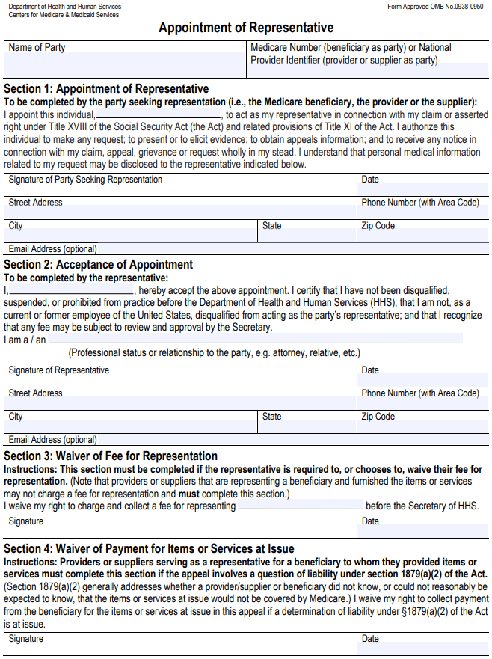
CMS FORM 1696
Appointment of Representative (AOR)
Must be accepted by all Medicare Advantage plans – cannot require a different form
Sections 4 not applicable to Medicare Advantage because the Plan’s Evidence of Coverage dictates any cost-sharing responsibility, unchanged by this form
Providers cannot charge a fee for representing enrollee
Valid for 1 year, and for life of an appeal
Use when a payer says – we will only speak to the ATTENDING! NOPE!
USE THE FORM TO BE PRO-ACTIVE

Slide 47
Proactive Ideas for all non-Traditional Medicare/TM Contracting
Usually in Operational Addendum & Appeals
Outline key elements prior to signing the contract. Re-visit throughout the contract year if concerns arise. Rates are not included in this list.
Timeline for submission of clinicals. Week days, weekends, obs conversion request to inpt.
Clinical guidelines the payer is using making the inpt decision along with required REASON for not approving inpt with decision.
Timelines for reply of request. Weekends same as weekdays. 4-8 hrs maximum
Once inpt has been approved, no additional record requests unless pt is a candidate to move to a post-acute level of care. Contract language must be known – i.e. qualifying stay. (DRG)
If granting access to the provider’s electronic medical record, critical to have a very limited review (ER if from the ER/labs/imaging/notes) with a firm timeline for decision. 4- 8 hrs maximum. Continued delay yields risk of the pt ‘recovering in a lower level of care/obs.” If in obs, grant access when the pt’s condition needs reassessed. 8 hrs maximum.
DRG hot spots: Sepsis, ensure there is adherence to the HIPAA Standard Transactions- all covered entities.
MA plans: Ensure there is understanding that a disputed status may not resolved while the pt is in-house. TM rules do not apply. Status can be changed post discharge will full billing as inpt or outpt/131 bill type.
P2P: Any provider may discuss the account on the patient’s behalf. All contracts allow both concurrent and post-discharge P2P. Once the request is made, a time is agreed to /recommended. Identify timeline with penalties if not adhered to. Agree to the qualifications of the payer MD. Outline the scope of the Payer MD can use –beyond meeting the clinical guidelines. No minimum LOS to be an inpt. (EX: all accts under 48 hrs are obs.)
Re-admission denials. Outline exactly what is a ‘related’ case within 30 days. “Same as Medicare’ = same day, same facility, same dx. Chronic dx are excluded. Identify which dx must be the same and in which ‘spot’ of the up to 10 dx.
Notes:
Consider splitting into two slides

Slide 48

CMS Contacts for Regions 1-10 ( 7-21)
File complaints – squeak – with excellent examples of abuse
Will require the provider try to work it out with the payer first. Then file.. *Cannot be regarding rates*
Region 1 | Robosora@cms.hhs.gov | CT, ME, MA, NH, RI, VT
Region 2 | Ronycora@cms.hhs.gov | NJ, NY, Puerto Rico, Vir Islands
Region 3 | Rophiora@cms.hhs.gov | DE, Dis of CO, MD, PA, VA, WV
Region 4 | Roatlora@cms.hhs.gov | AL, FL, GA, KY, MS, NC, SC, TN
Region 5 | Rochiora@cms.hhs.gov | Ill, IN, MI, MN, OH, WI
Region 6 | Rodalora@cms.hhs.gov | Ark, LA, NM, OK, TX
Region 7 | Rokcmora@cms.hhs.gov | IA, KS, MO, NE
Region 8 | Roreaora@cms.hhs.gov | CO, MT, ND, SD, UT, WY
Region 9 | Rosfoora@cms.hhs.gov | AZ, CA, HI, NV, Pacific Territories
Region 10 | Rosea_ora2@cms.hhs.gov | AK, ID, OR, WA

Slide 49
Payers- United – Largest payer
Contract and Policies/Webpage. Mid –year changes?
**United revenues will hit $243B-$245B in 2019. 4-21/1st Q Reports profit increase of 44% $5B**
United Healthcare
Continues to buy companies that work directly with hospitals. Advisory Group, Optum, physician groups, physician advisor groups/Sound. Change healthcare 2-21
NEW: Site of Service determinations for outpt procedures. URG-11.03 eff 5-18.
“UnitedHealthcare’s Policy will limit outpatient surgery to hospitals…will only pay in an outpt hospital setting if the insurer determines the site of service is MEDICALLY NECESSARY. ..’hopes to guide patients to ambulatory surgery centers. “ 10-19
Post ED Audits for “emergent coverage.” CMS states in violation of Surprise Billing rules. Other payers too with like issues… get our A Game on!
United Healthcare owns Optum
Effective 3-18, ER Facility E&M Coding Revision for commercial and Medicare Advantage plans.
Polices focus on ED level 4/99284 and level 5/99285 – whether the provider is contracted or not.
Using Optum ED Claim (EDC) Analyzer tool which uses presenting problems, dx services provided, and associated pt’s co-morbidities.
**Humana added this audit as well 8-20**
Surprise Bill Leg: Outlaws retroactive/post discharge ED denial policies. 7-21 /CMS

Slide 50

More Payer Challenges- Anthem and Imaging
*Anthem is the largest for-profit organization of BCBS*
Anthem BC – Discontinuing coverage of outpt imaging at hospital. “IMAGING CLINICAL SITE OF CARE.”
Directing patients to Free Standing Imaging Center for CT and MRI.
2017- KY, IN, MO, WI. Added CO, GA, NV, NY, OH, CA. March 2018- added CT, Maine and VA. 13 states impacted & more
Pt steerage, limiting patient choice and labor cost to do prior authorization for CT and MRI. Some exceptions – Rural, tied to pre-op services.
Quality of care, availability of the reports, interoperability limitations, Rad provider interpreting = all listed as concerns.
CONCERN: Service is authorized but not at the hospital requested/ Insurance picks cheapest site of service.
HUGE THREAT TO REVENUE THROUGH OUTPT SERVICES. “Front Door” is being impacted by payers and new competitors /non-traditional.
With Site of Service referrals – what is the WIN for the providers in return for giving reduction from billed charges?

Slide 51

Payers – Changing Climate
Amerigroup/An Anthem company
Effective 7-20/non-participating; 9-1-20/participating. Applicable to ED services provided.
Emergency Condition: Condition that a lay-person with an average knowledge of health and medicine could reasonably expect the absence of medical attention to result in serious health jeopardy.
Prudent layperson: To reasonably determine whether an emergency condition exists. Does not have healthcare training with a HC education.
Only process ED facility claim as emergent.
Criteria: ICD-10 Emergent Dx have been identified in ‘specific’ claim fields- Primary DX =field 67. https://providers.Amerigroup.com/TX
“CVS agrees to buy Aetna in $69B deal that could shake up healthcare industry.” 2018
“We want to get closer to the community as all healthcare is local. “
CVS would provide a broad range of health services to Aetna’s 22 M member at its nationwide network of pharmacies and walk-in clinics.
Think out of network for other pharmacies.

Slide 52


Payer + Provider: ‘Long road from Contention to Cooperation.” Money=Power
‘Anthem/BC (Indianapolis-based) determines ER visits are not covered for 300+ diagnosis. *Non-emergent* 2018>
Impacts Kentucky, GA, Ohio, Indiana and Missouri. 40M+ BC members. (And more nationwide rollout)
Exceptions: under 14, on IV/new, no other care weekends, physician referrals to the ER, a lack of urgent care available.
American College of ER Physicians:
“The changes do not address the underlying problem… pts have to decide if their symptoms are medical emergencies or not BEFORE they seek treatment.”
If the diagnosis does not warrant ‘emergent’ under the payer-specific guidelines, there is on payment to the hospital and providers.
EX: Pt in Frankfort, KY –after experiencing increasing pain on her right side of her stomach, thought appendix had ruptured. ER tested, diagnosed with ovarian cysts.
Patient owed full $12,000
Denials are based on FINAL diagnosis; with little ‘weight’ for presenting diagnosis.
Anthem believes 10% reviewed/4% denied
“This will create deaths. This will make the pt think twice before going to the ER.”- BCBS TX Physicians

Slide 53
Payer: all payers
Physician office E&M new guidelines, only
Biggest change to E&M since 1995/97
Only impacts office E&M visits
Audit risk: Carefully monitor bell curve.
Medical decision-making vs time for entire day/all providers. Which is most accurate for each visit? Who is making the decision? What new /revised documentation was created?
Patients over paperwork. Saves 2 min per visit/forecast.
Suspended 2% payment adjustment (sequestration). Ex Order to delay implementation of the sequestration thru 2021. Increased cuts in 2030 to pay for the delay. 4-14-21
G2211/add on code is now bundled until Jan 2024 . G2212/prolonged (new)
BEWARE BUDGET NEUTRAL! Winners and losers: proceduralist lost payment to allow for office visit providers to have gains. Relative value weights went up for office visit practices. Conversion factor down 10% from 2020 but thru end –of-year legislation, only 7% reduction for 1 yr. What about the other payers and their provider contracts? How are they paid?
New CV & RVU = significant potential increases in $ for primary care w/0 increase in volume. Impact to employed /contracted providers.
Post visit audits: Both compliance and revenue options. (1995 vs new time vs new MDM)

Slide 54
Short Term Health Insurance –
4 things to know (Becker Hospital Review 8-18)
Trump Administration released FINAL rule for short term health insurance plans/STP. Open ended with coverage.
“State Relief & Empowerment Waiver/1332” – state can offer less 10-18 (Judge upheld selling 7-19)
Previously could only offer 3 months, now can last up to 3 yrs.
1) STP do not have to abide by the rules by the ACA requiring coverage of essential health benefits and pre-existing protection. Nor do they have to abide by insurance plans imposing limits on how much care is covered or the requirement that at least 80% of premium money go toward care.
2) Not abide by ACA, STP do not cover as much as more comprehensive plans. They tend to not cover: maternity, prenatal care, mental health, drug treatment and prescription drugs. May not cover sports injuries and other specific services like cataract treatment, immunizations, and chronic fatigue or pain treatment.
3) Some do not cover $250,000 - $2M. Others only covered inpt on weekdays, others with waiting periods.
4) Generally they are cheaper than the ACA plans. Kaiser study found ex) 40 yr old single man in Atlanta was $371/ACA compared with $47 for STP.
BUYER BEWARE! Less coverage = more out of pocket if healthcare is used. (Biden Adm. assessing/allowing. 6-21)
1/3 of all small employers state that health insurance and healthcare costs are their major concern. 3-21 (Healthcare Dive)

Slide 55


A day in a life of ‘junk insurance‘ and coronavirus/COVID-19
FL patient, 3-20
Been to China recently. Had flu-like symptoms. He followed advise of public health experts and went to the hospital for testing.
He tested positive. Staff said needed to have a CT scan too.
He received a bill for $3270. Insured but with ‘junk insurance’ which offered limited benefits and DID NOT COVER PRE-EXISTING.
Based on his ins, he has to pay $1400. BUT to get the claim paid, at all, he had to send THREE YEARS of medical records to prove that this ‘flu’ was not related to a pre-existing condition.
He pays $180 a month in premiums.

Slide 56

More Payer-Provider Challenges - Cigna
No longer paying drug administration
Effective 5-19: Reimbursement policy for infusion and injection
“We routinely review our coverages, reimbursement and administrative policies… In that review, we take into consideration one or more of the following: evidence-based medicine, professional society recommendations, CMS guidance, industry standards and our other existing policies.”
‘As a result of this review, we want to make you aware that we will NO LONGER SEPARATELY REIMBURSE infusion and injection administration services billed by facilities because infusion and injections administration services are considered INCIDENTAL TO THE PRIMARY SERVICE and are not separately reimbursable.”
“The affected CPT codes: 96360-96379 and 96521 thru 96523. This aligns with our current reimbursement policies for facility routine supplies. (EXCLUDES: Chemo 96400-530 and sub-inj 96372)”
NOTE: “In Nov, 2018, we began applying this update to claims from the ER DEPARTMENTS. This updates expands to all areas within a facility.”
  (No observation or ER. What if have chemo and non-chemo drugs at the same treatment time?)
WOW! A) What is the primary service that is being paid? B) If it is drugs, are you getting full billed charges as it must now cover all visit and all infusion costs C) What about the ER visit or HBC visit?

Slide 57

Payer + Provider = New payment relationships
AHA, AHIP and 4 other associations (AMA, BC/BS and MGMA) join to improve prior authorization processes. 1-18
Six healthcare groups agreed to take steps to make prior authorization processes more effective and efficient.
Decrease the # of providers required to comply with prior authorization based on their ‘performance, adherence to evidence-based medical practices or participation in a value-based agreement with the health insurance provider.”
Prior authorizing only “high value services’. Insurance plan is determining what value-based payment looks like… is this really value based care based on the physician’s assessment & believes best care plan? Who decides?
Disney partners with 2 Florida health systems to offer HMO. 2-18
Directly contracted with Orlando Health/6 acute hospitals and Florida hospital, Orlando/20 campuses to roll out two insurance plans for Disney employees.
Goal: lower healthcare costs, higher outcomes
Using Cigna/Allegiance to administer the program.
NOTE: Remember employer-owned insurance is still looking for ways to reduce their costs..
11% of employers are looking at Direct to health system./ National Bus Group
2021- increase in employer direct to provider contracts
TRUST IS THE KEY WITH NEW VALUE BASED RISK CONTRACTS- provider and payers. Who is developing the quality matrix, non-compliant patients, IT functionality, patients understanding of the term VALUE BASED, providing all services to keep leakage from occurring, provider choice, etc. Value over volume.

Slide 58

Post –discharge, outlier payment, line item audits. Commercial, MA, Medicaid Mgt Care. Each payer has their own list, their own justification, internal.
If paid by DRG and an outlier payment is expected, here come the line item audits. If paid a % of billed charges, here come the audits.
Absolutely a contract issue. Join other providers. Strategize. Charge the payer for sending records, make decision to discontinue the contract, etc.
What to expect? CMS: R&B covers routine services =nursing. Defined?
Unbundling: Disallowing any separate nursing charges. R&B covers all nursing inpt uniquely ordered services. Separately ordered, separate CPT coded during obs or inpt not covered. NO venipuncture, in-room pt specific ordered treatments/blood transfusion, ICU/ ventilator daily, drug adm, Conscious sedation, assisting provider with procedures/any setting, CPR, suctioning.
  Routine: Surgeries. Disallowing many unique to the patient, unique to the surgery charges. All covered in the per procedure/per time charge

Slide 59
Impact of Surprise Billing on post payment denials! All size hospitals.
Still fully being developed, but HUGE focus on surprise bill to the pt.
If a good faith estimate is made prior, and the claim is billed in line with the provider order, knowledge of reimbursement rules (one set for all payers) and then post submission, payer does audit and denies-impact to pt?
Provider accepts change to obs/post discharge – pt has a new out of pocket. (Or provider elects not to bill the pt due to financial hardship)
Payer assigns liability to the provider and says nothing can be billed to the pt. Where does it say that is allowed in the contract? This is arbitrary and means the provider has 100% loss of denied items.
Provider challenges all denials – but cost is high to fight – gives up and accepts payer decision. Why? The message is – yes, we committed abuse and possibly fraud for billing this way or for these services. Keep auditing and imposing rules and making us absorb all. And then go after my friends and neighbor hospitals too. The payer can say – we had ___% who agreed with our findings. Wow!

Slide 60
Hot spots for audit- Payer and internal – CHARGE CAPTURE
Does the order match the service documented that matches the billed item/UB- the 3 step! (charge/chart audit)
Hot spots for audit:
Wastage – Single dose vial/SDV vs Multi-dose vial/MDV; SDV wastage must be documented to bill. No ability to bill wastage with MDV. JW modifier is not required for drugs that are not separately billable. CAH paid billed charges. (CMS pub 100-04 Chpt 17, section 40) Nursing, pharmacy, RT, imaging, anesthesia = hot!
Original order changed after receipt.. Did referring physician’s order change in the record?
Protocol – must be ordered pt specific
      (OB, LAB/CBC vs CBC w/diff, Imaging, RT, pharmacy, others?)

Slide 61

And then there was Charge Capture-- Identify areas of concern- VALUE ADDED
Lost Charges/Revenue w/Compliant orders/documentation
Daily Charge Reconciliation
Cost of Late Charges
And easy chart/charge audit ideas to identify documentation challenges and charge alignment

Slide 62
Hot Spots for Lost Revenue
Recovery – house wide – up to 4-6 hrs
Nursing services in ancillary areas *
Drug Administration – Observation
OB –HBC scheduled visits, delivery rates/levels, labor levels, unplanned *
Hospital based clinics – E&M visits
Blood transfusion – house wide (Bld & Giving Bld)
Scheduled procedures done in the ER *
OR – Implantables & invoice reconciliation *
OR – unscheduled, interrupted/7x modifier
Ancillary – reduced/52 modifier *

Slide 63
Denials and being the patient advocate. A Financial Navigator for the most vulnerable. Pt loyalty means?
And when the payer decides to deny a claim, the patient is overwhelmed.
Who is the provider navigator to help defend the denial or dispute w/payer?
Ex #1 Pt had a burn on lower leg. Insurance paid for the dressing but then stopped paying. Denied as not medically necessary. Didn’t know where to go or who to help. Ended up calling their insurance agent/who sold the MA plan. The agent called the insurance and told the pt – nothing they can do. He paid out of pocket for multiple months.
Ex #2 Pt’s insurance changed after the pt had 3 corrective surgeries. Specialized surgeon and procedures. A 4th surgery was necessary, but out of network. Pt asked their human resource /broker –nothing to help. Then directed to call the insurance directly and ask for help. After another denial, a navigator –advocate stepped in. Outlined the surgery, involved the surgeon to discuss the case directly with the payer, and asked for exception to continue with the same pt care and surgeon. Insurance plan said – there are plenty of in-network ortho surgeons. Now the battle to prove – can’t change and no surgeon would take over this level of complexity. After many calls, the pt and advocate did get limited approval. Then after-care denied. (Can’t make this stuff up!)
Ex #3 Pt had muscle pain with inability to dx without a test. A Vit D test was ordered as this was the accepted course of dx work- up for uncontrolled muscle pain. Insurance denied as not medically necessary and they had their own indept company who confirmed same. When told that the doctor needed to determine the level of Vit D –as it is directly related to the reason for muscle pain – didn’t matter. Pt was told they had to pay it and other services related to the Vit D test. Pt asked the provider –what can they do? They stepped in and did do an appeal. All for a simple Vit D test.. Otherwise, the pt is left paying.
The complexity of healthcare – the relationship between the payer and the patient –all difficult for the pt who only believes:
If the physician ordered it, why did the insurance declare it as not medically necessary?
Physician directed care vs payer directed care. So very hard on the patient. Who can help them? Who actually knows what to ask? Payer’s going wild directly impacts the most vulnerable – the patient.

Slide 64




Thank You for Joining Us in this
Educational Journey
DAY EGUSQUIZA
President, & Founder
AR Systems, Inc. &
Patient Financial Navigator Foundation, Inc.
daylee1@mindspring.com
208 423 9036
http://arsystemsdayegusquiza.com
http//pfnfinc.com

