Slide 1
Exploring an Integrated Clinical Documentation Improvement & Education Program
Day, Egusquiza, President
AR Systems, Inc

Slide 2
What does “Integrated CDI’ mean- 2 step?
Patient status /UR coming together with traditional CDI/coding to create a coordinated, cohesive effort to ensure documentation in the medical record to support BOTH inpt status or observation PLUS the most complete diagnosis to support correct coding and ICD -10.
Third step –include ordering ‘rules’ to match what was documented and billed. (3 step)
Cross training = more staff= 1 voice

Slide 3
Why have Clinical Documentation Improvement?
A consistent ‘set of eyes’ on the record
Concurrent review, with direct feedback
Concurrence –
  Handoffs between ED and the hospitalist – pt status
  Consistency with the ‘reason for admit’ throughout the pt’s stay/story
  Continuous feedback loop to the provider, nursing and others documenting in the record
  Detailed, diagnosis to avoid queries
  A VISION FOR CHANGE…KEY TO THE SUCCESS

Slide 4
What efforts are being done to ensure the record can support the pt status and is coded correctly?
CDI specialist
Focus: concurrent interaction with providers to ensure co-morbidities and other complications are well documented.
AND ICD 10 is here. (It is going to take a while.)
Protecting DRG /case mix
UR/Case mgt
Focus: work to ensure the patient status is correct and supported by the physician’s order (and run reports & insurance work & criteria)
Clarity of documentation requirements.

Slide 5
Do we have enough resources to do it all well and add charge capture ownership? Any? Or some?
With new challenges and demands on documentation – time to think new, creative (even scary thoughts) = AN INTEGRATED CDI PROGRAM/TEAM APPROACH

Slide 6
A Fully Integrated CDI Program
LOOKS AT…….

Slide 7
Three distinct documentation challenges (Coding/ICD 10, Pt Status and Charge Capture) , incorporate them all into 1 integrated CDI program with focused education for all ‘at risk’ patterns thru coordinated CDI specialist/trainer(s)
WIN WIN WIN- 1 voice of education with the providers/clinical team, cross trained team with more eyes in the record.

Slide 8
Correct coding
Coders back end clean up
CDI specialist – front end, more interactive
Pt status
UR/Case Mgr – both front end and back end
Charge Capture
Dedicated staff
Internal auditor – only upon request
Auditors –denial /appeals
Few individual depts doing
Tracking and trending patterns?
Tracking and trending patterns?
Tracking and trending patterns?

Slide 9
Let’s look at how and why to implement an integrated approach
Limited resources and still need to do it ‘all’
2) Providers confused, push back, lack of buy in, inconsistent message from multiple staff
No effective change in documentation –difficult to sustain – fragmented efforts.
Too darn many denials with no change in patterns
IS THE PAIN BAD ENOUGH TO SAY: TIME TO MAKE A CHANGE

Slide 10
Step One: Pt Status

Slide 11
All Payers are auditing…
Each payer has their own set of ‘criteria’ for coverage.
Each payer has their own standards for appeals
Each payer determines if the documentation supports the service that was billed.
And then the provider community gets to keep the money the payer paid.

Slide 12
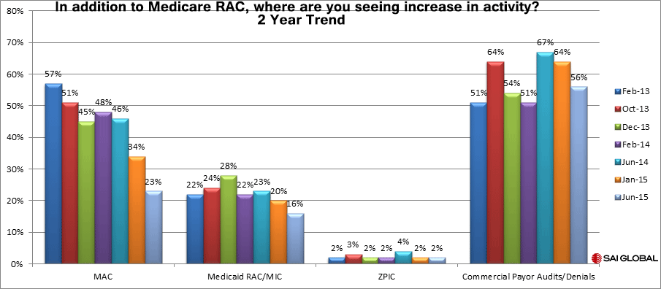

Slide 13
Key elements for Payers- as ordered by providers
ALL PAYERS
Admit to inpatient
Diagnosis
Reason for Admit/Plan for why an inpt for dx.
All part of a pre-determined order set.(Ques in the EMR or paper)
MEDICARE ONLY
“Clarify” that the LOS is an estimated 2 MN/Presumption
“Clarify’ that after the 1st outpt MN, a 2nd ‘in hospital’ MN is required/Benchmark
After 1-1-15, provider still outlines why the 2 MN, what is the plan that will take 2 MN. No longer ‘certify’ but still needs to clarify the order/signed prior to discharge and rationale for the 2 MN. (Do certify 20 day mark/outlier)
Critical Access Hospital – must still certify initial 96 hrs and again, at the 96 hr mark.

Slide 14
Hot Spots for Documentation audits – inpt and obs
Does the physician clearly state: Why an inpt? What is the plan that will take 2 MN/Medicare? For non- Medicare – why can’t the pt be treated safely as an outpt. (Same issues as Medicare-just no 2 MN declaration)
Medicare/only-If the pt needs a 2nd MN after 1 MN as an outpt – what is occurring with the pt’s condition that will ‘push the pt’ to stay a 2nd MN? Convert to inpt and include: Why?
Mgd Care Medicare/PartC/Medicare Advantage – HIGH AT RISK. What criteria are they using? Get it in the contract! NOT SUBJECT TO TRADITIONAL Medicare rules
Commercial Mgd Care or Commercial- who knows? Makes their own rules for disallowed charges.

Slide 15
Huge Managed Care /Part C/Advantage Issues
USA July 27th reported 2 huge potential purchases:
Anthem BX purchase of Cigna
Aetna purchase of Humana
Making United the last of the 3 powerhouse companies.
WATCH: Denial for the catch phrase: not medically necessary! MEANS?
Negotiating will be more difficult.
Ensure there is artibtration in all contracts.
Define an inpt-with no ability to do retro denials ‘after discharge.”
Timelines to certify inpt status.
Hot issues with denials or lack of inpt certifications:
Long LOS in obs with no ‘rules’ for conversion to inpt
Each payer gets to define their own coverage rules
Following the 2 MN Medicare Traditional rule AND clinical guidelines. (EITHER Interqual or Milliman.)
Levels of appeal clearly included – clarify why not following the 5 levels within CMS’s process. Timelines for each and who does what.
Denials of coverage ‘after discharge’ as the pt ended up getting better faster/not as sick as presented on 1st contact/ other
HAVE AN ATTORNEY READY !!

Slide 16
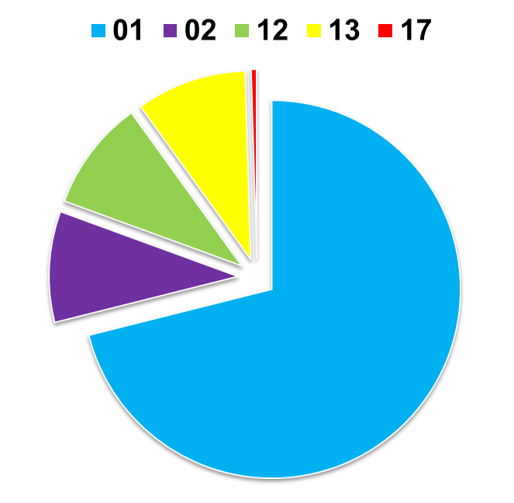
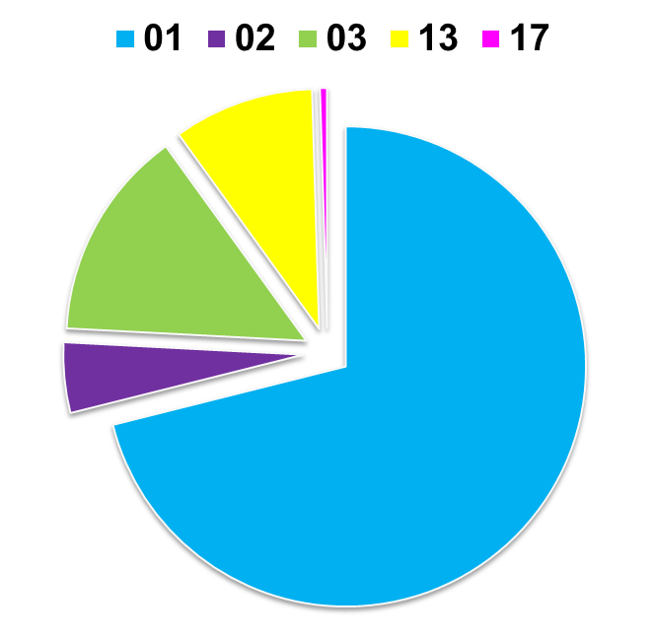
Denials by Type – WPS
1st and 2nd Round P&E
J5
5PC01 | Documentation does not support services medically reasonable/necessary
5PC02 | Insufficient documentation
5PC12 | Order missing
5PC13 | Order unsigned
5PC15 | Certification not present
5PC17 | No documentation of 2-midnight expectation
J8

Slide 17
Top Reasons for Denial – Second Round- Novitas/2nd round of P&E
Denial Reason | % Denials JH | % Denials JL
Documentation did not support two midnight expectation (did not support physician certification of inpatient order) | 56% | 53%
No Records Received | 16% | 17%
Documentation did not support unforeseen circumstances interrupting stay | 4% | 3%
No inpatient admission order | 9% | 15%
Admission order not validated/signed | 11% | 11%
Other | 4% | 1%

Slide 18
P&E findings: First Coast/MAC
244 hospitals: FL, PueRico, VirIsland
1st round:
  35% denial rate
REASONS:
  55% failed to document need for 2 MN
  45% failed admission order requirements
    48% signed after discharge
    39% order missing from the record
    13 % order not signed
2nd round:
  36% denial rate
REASONS:
  40% failed to document need for 2 MN
  60% failed admission order requirements
    35% order missing from record
    17% order not validated
    8% order not signed (as of 2-11-15)
  MAC recommendations:
  Providers document their decision making process. Paint a clear, concise picture of the pt.

Slide 19

Tell a better, more complete patient story
Begin with the 1st point of contact – ER, direct or Surgery
Why is the pt not safe to be discharged/ED?
Why is the surgery an inpt if the CPT is not on the inpt only list? (Medicare only)
What provider laid out a plan for why 2 MN for a direct admit to the floor? Did the hospitalist see the pt immediately? Did UR talk to the ordering provider?
Who is validating status for transfers in? Who is asking both the sending and the receiving the 2 MN question? Count 1st in sending.

Slide 20
Key areas to support documentation for pt status
Admitting physician ‘starts the pt story’ thru use of the clarification of order process – including REASON FOR ADMIT.
Internal Physician Advisor- trainer/champion, works closely with UR and all providers to ensure understanding/compliance.
Nursing continues with the care/assessments/interventions relative to the reason for admit.
UR works with the treating/admitting physician to expand/clarify the documentation at the beginning and conclusion of the patient’s stay. Additionally UR closely monitors completion of the certification for ALL payers.
Integrated CDI continually interacts with providers/nursing to ensure all elements are clear /complete . 1 voice of ongoing education…

Slide 21
Identify ‘place and chase’ with UR
What are the daily hrs of coverage for UR?
Is there UR in the ER and if so, hrs?
Have patterns of poor admission orders and action plan to support both OBS and inpt status been tracked and trended? Discharge challenges included.
What changes have been made to attack the new 2 midnight Medicare rule? Same for all payers?
Are outpts ‘in a bed at midnight’ in a dedicated area for ease of tracking? converting if 2nd MN?
FIND YOUR LOST INPATIENTS!

Slide 22
Step Two: Coding Focus

Slide 23
2) Correct Coding – the 1st time
CDI concurrently reviews
Receives ‘problem/concern’ from coders
Interacts with the providers daily
Has established relationship
Eyes of the back end coders
Reduces queries thru interactive dialogue
Ongoing education with providers

Slide 24
And then there was ICD -10
Oct 2015 and after go live
“Easy” ways to show new way of documenting
Better documentation = ques, auditing to ‘see’ at risk, ongoing support
Track and trend queries to incorporate into training
Teach with audited examples, made easy.
Ongoing audits/concurrent
Doctors take lead from hospital = positive message

Slide 25
ICD -10 Continues the Documentation Enhancement Story
Along with focusing on enhanced documentation to support inpt level of care, the expanded narrative to support ICD 10 conversion continues the story.
Support team to make this happen: Integrated CDI with feedback from coders
PFS /denial ‘busters’ with feedback to CDI
Payer new edits –PFS monitors and advises
IT with ability to test, submit, and maintain both ICD 9 and ICD 10 post go live.
Eyes in the record – nursing/24-7.

Slide 26
Departments who are impacted by ICD -10 changes
1st point of contact =provider offices/dx to get pre-certifications with payers.
Pre-auth with payers = internal staff, UR
Medically necessary edit = diagnosis to screen diagnosis against CPT tests to determine if Medicare or other payers will allow. ABN completed with Medicare pts prior to the test.
Internal IT, scrubber company, payer’s IT systems = prior to go live and post go live.
Concern: Worker’s Comp and Liability not covered entities/HIPAA Standard Transaction. Maintain both ICD 9 & ICD10??

Slide 27
More areas impacted by ICD 10
Lab, Chemo, Imaging, Cardiology, Specialty services = all usually require “medically necessary payer screening” prior to the procedure. Cheat sheets = gone!
Doctor offices = new encounter forms.
Rehab = Work comp pre certs. (? ICD 9 & 10)
PFS = new rejections, new return to provider edits, potential new denials
HIM/the clean up crew = all payer rejections due to coding, internal issues, more?
IT decision support = historical to current codes
Others? = any area tracking by Dx code…more!

Slide 28
Step Three: Charge Capture

Slide 29
Golden rule = Billable service
3 questions – the 3 step!
Does the order match…
What was done/documented…
That matches what was billed?
Hot spots: protocols, changes from ordering physician by ‘other providers’, lost charges due to lack of ownership, wastage documentation for SDV.

Slide 30
3) Charge ownership
Who owns completeness of the charges? Manual and/or electronic?
Is a daily charge reconciliation process done – aligning orders with charges?
Is there a dedicated charge capture analyst for certain ‘nursing difficulty with accuracy’ items – like drug adm in an outpt setting?
Any known hot spots? (Surgery/Drugs, supplies, pharmacy)

Slide 31
Case Study – how a midwest health system made it work! Lori Rathbun, VP Financial Services; Deb Chenchar-Theisen, Network Nurse Executive.
Yeahhooo!!

Slide 32

MHN Central Iowa Division Results
15 hospitals in MHN’s Central Iowa region participated in Clinical Documentation Improvement Request for Proposal.
15 hospitals very satisfied with results and well on their way to improve documentation and tell the story leading to patient safety, quality, and ultimately appropriate reimbursement

Slide 33
Mercy Health Network
Identified Top Priority among CEO’s, CFO’s, HIM and Revenue Leaders
Request for Proposal – Team Established to drive proposal
We had to get real about our CAH realities and craft a proposal that works for our needs
CDI, HIM, Physicians, Leadership on board for sustainability of program
Education & teaming –
Clinical Leadership – Top success measure
Success Measure - identification of CDI specialist
HIM coders are not the lead CDI specialists
Program Implementations - Audits – November 2013
CDI Specialist Education November 2014
Site visits Leadership, CDI, Nursing, HIM and Physician Education – Dec/Jan 2014
Coding Education - April 2014

Slide 34
Mercy Health Network
Clinical Leadership in place across network
CDI specialists named and working with physicians
HIM leadership teaming with CDI and providers monthly
Review of documentation and practicing transition to ICD10
Regardless of delay of ICD10, CDI critical to quality and patient safety – continue education path as a network.
Sustainability critical to moving to the next level so we practice and make this part of our monthly network meetings for practice
Feedback from hospitals
Excellent program design focused on improving CDI, coding, physician understanding and adoption. Well positioned for future transition.

Slide 35
Audit current inpt and obs:
1) Patient Status – Inpatient vs. Observation.
Audit of existing documentation to determine current understanding of documentation requirements – for the physician as well as nursing. With the new definition of an inpt, this type of auditing and education is timely and critical.
5 2MN presumption, 5 2MN benchmark, 5 ER to obs to discharge, 5 Postprocedure to recovery to obs to discharge.

Slide 36
2) Audit for at risk coding
Audit up to 5 records for all providers
Identify audit sample from a) high volume, b) known weak documenting providers, c) coder feedback d) ICD -10 major change areas.
ICD -10 accuracy , provider/patient specific.

Slide 37
Audit order to documentation to UB 04/billing document:
3) Charge capture
Audit of existing ‘hot spot’ departments – surgery, ER, observation – with a focus on identifying under charges as well as over charges that includes ‘challenges of orders matching what was done and billed.
  Line item audit to match order to documentation to UB

Slide 38
Next – Share results from Audits, UR and Coder Feedback – Sr leaders buy in
Time to do education with impacted areas
Physician, nursing, dept heads = all owners of an integrated CDI program
No final decision yet on how to integrate – just learning the current processes

Slide 39
Finally – brainstorm how to move to 1 consistent message of education
Leadership facilitates the brainstorming session –sharing the goal:
  To create a single, integrated system of CDI specialists within the organization.
  To create a consistent message of how to fix what was broken from the audits- coding/ICD 10, pt status, charge audits.
  To create a single, training message to providers with the ‘pearls’ from all the audits (as providers are the key in most audits)
  To ensure no silos exist within the organization
  To identify EMR enhancements to guide/coach/que and hard stops as necessary.

Slide 40
EXCITING Kick Off Education with audit results – who of the UR , CDI, case mgt or others are the best trainers for the integrated team?
Within a very short time frame, create a timeline for a 1 day kick off. (All CDI team = 1 trainer/mgs)
Incorporate:
  Kick off Physician education:
    “What are documentation standards and why do I care“ –with EASY to implement documentation tools
    “Attacking the challenges of inpt vs obs- why is it so hard?” -with the tools for enhancing the patient story.
    Determine if ‘ensuring the order matches what was done’ requires a formal class or individual physician education but share the ‘big message’ of the facility’s commitment to CDI…

Slide 41
And additional clinical education
Nursing, nursing, nursing…. Has been left out of significant documentation training.
Ensure the audits include nursing’s role in enhancing the pt story. (Obs, inpt)
Ensure nursing understands how they can compliment the work of a dedicated CDI specialists – they are the eyes of the record 24/7 with immediate alerts.
Provides Quasi-UR work for after hrs and weekends when volume doesn’t warrant dedicated UR Staff.
Other hot departments? Ensure they meet with the CDI team to determine –next steps.

Slide 42
Ongoing physician education looks like….
Integrated CDI team (UR and Coders) and/or (UR, coders, charge capture) meet frequently to discuss – what is broken?
Develop training outlines to address ‘roll out’ of pearls of training .
EX)Post go live ICD 10- Nov/focus on ER; Dec/focus on Cardio; Jan/focus on Ortho with follow up by ALL the team on a daily basis
EX) Inpt status – Dec/focus on Inpt – all payer rules
EX) Chrg capture- Jan/focus on protocols ordered specific to the pt.

Slide 43
Final steps – roll out
Identify the ‘change team”: UR, Charge capture analyst, IT, revenue cycle denial team, HIM.
Invite guests as issues are presented: payer issues, regulatory updates, physician patterns, training developed.
Identify the primary trainers with all members of the integrated core team cross trained. (More eyes in the record)

Slide 44
Last step: Explore changing reporting relationships while consolidating into 1 clinical-focused educational voice- Director of Revenue Cycle with dotted…
Coding
ICD 10 audit and ongoing validation
Coding specialists work with providers
UR
Daily review of pt status at the time of the original order
UR documentation specialist work with providers
Charge capture
Daily review hot spots for lost charges
Option: report to Director of Revenue cycle—dotted line to Dept heads of individual depts
Option: report to Director of Revenue cycle --dotted line to HIM
Option: report to Director of Revenue cycle—dotted line to Care Mgt
Identify lost charges and documentation challenges-doc/dept head

Slide 45
Doing nothing …is not an option. Be creative in attacking the challenges of documentation to support billable services.
It is darn fun! Move forward with a new, dynamic approach to a challenging environment.
PS Don’t’ forget those pesty EMR’s too…they can help with creating ‘coaching/ques/queries/forms” – all tools.

Slide 46


GO TEAM! THANKS A TON

Slide 47
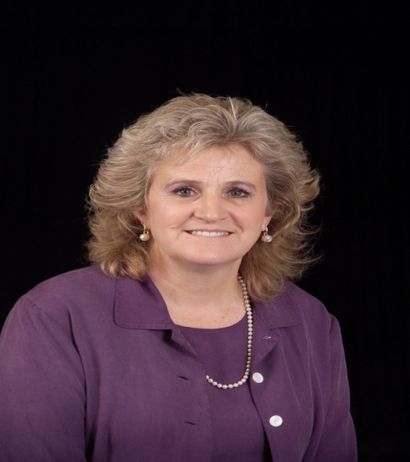
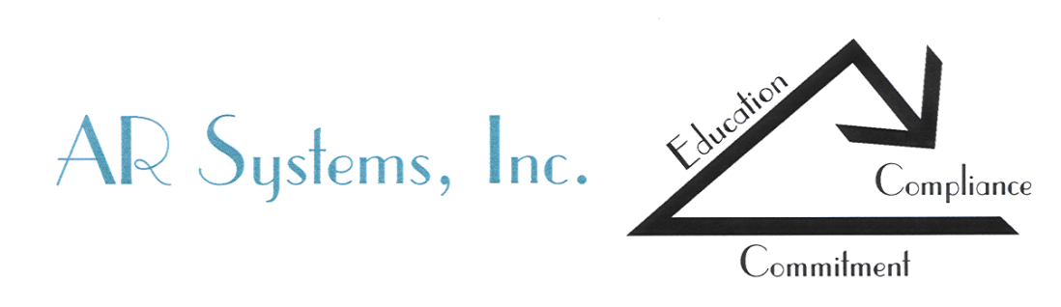
Thanks for a fun training time! daylee1@mindspring.com
Hey join us for the PA/UR bootcamp- July 2016
RACSummit.com
New web:http://arsystemsdayegusquiza.com
208 423 9036

